Slide 1
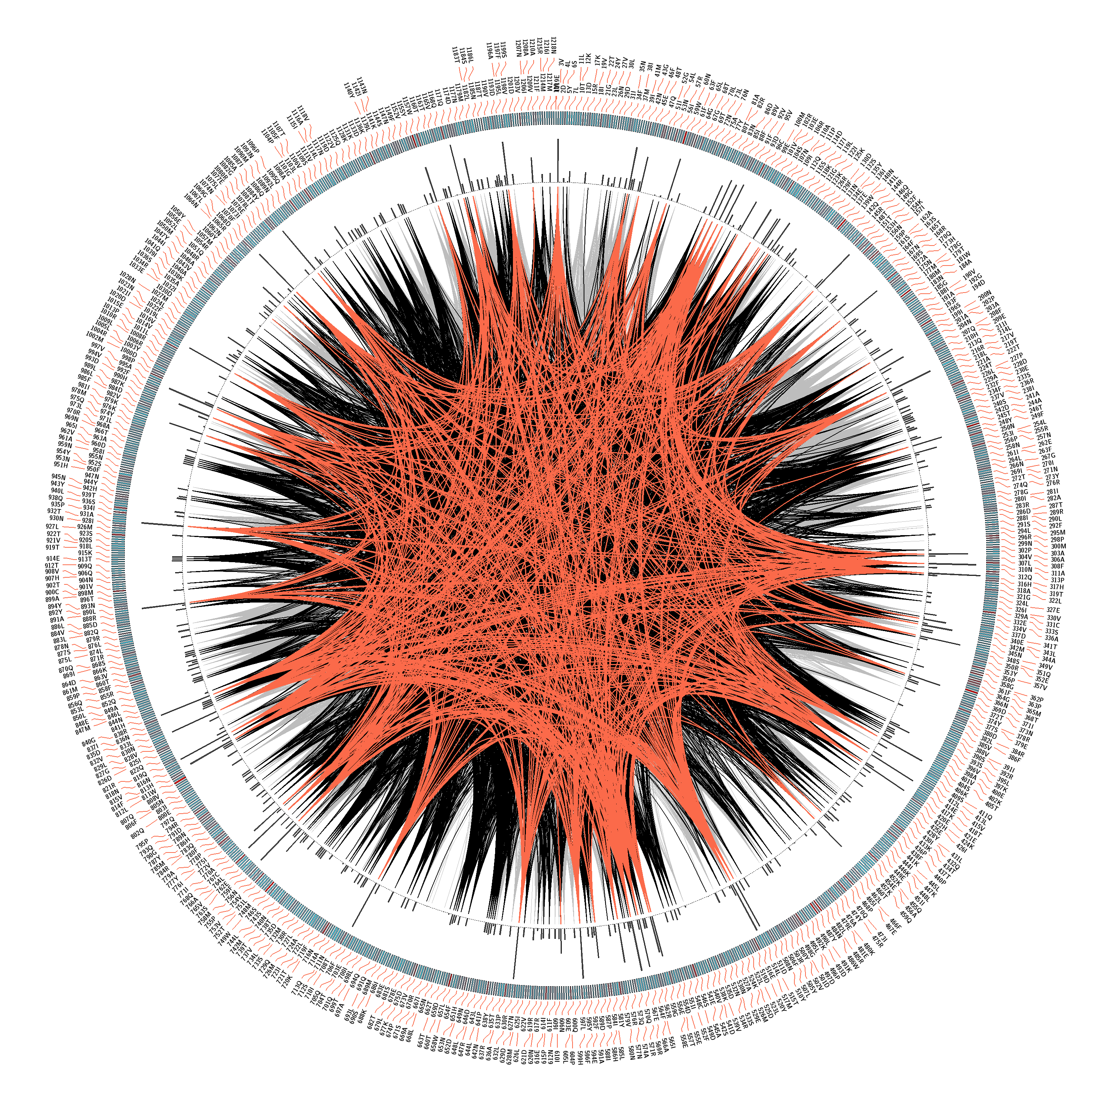
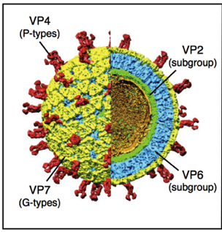
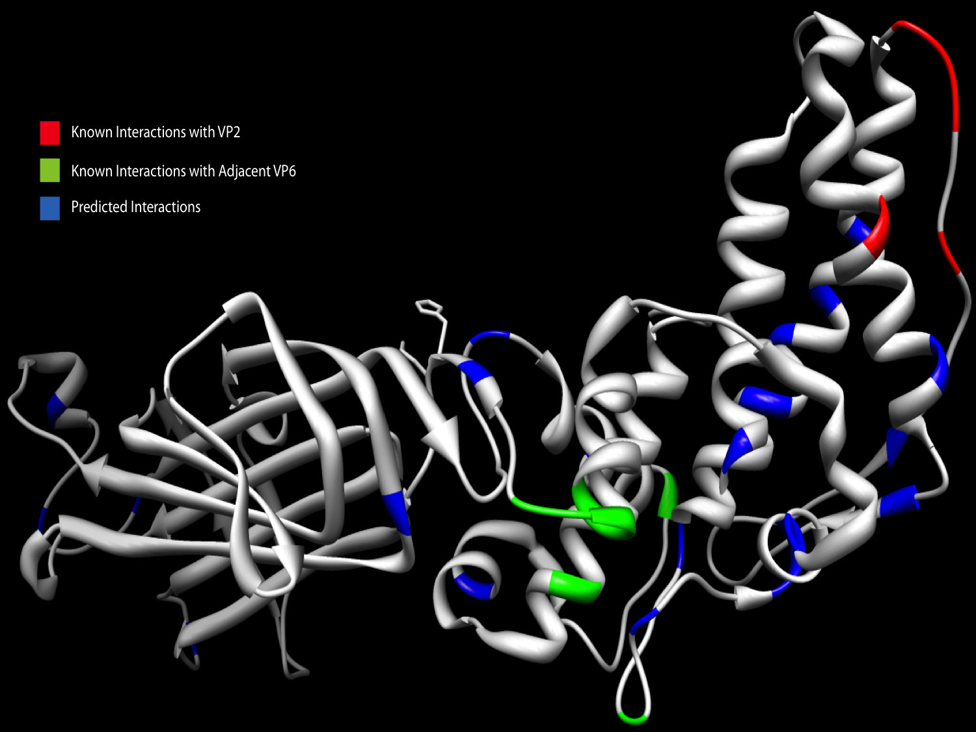
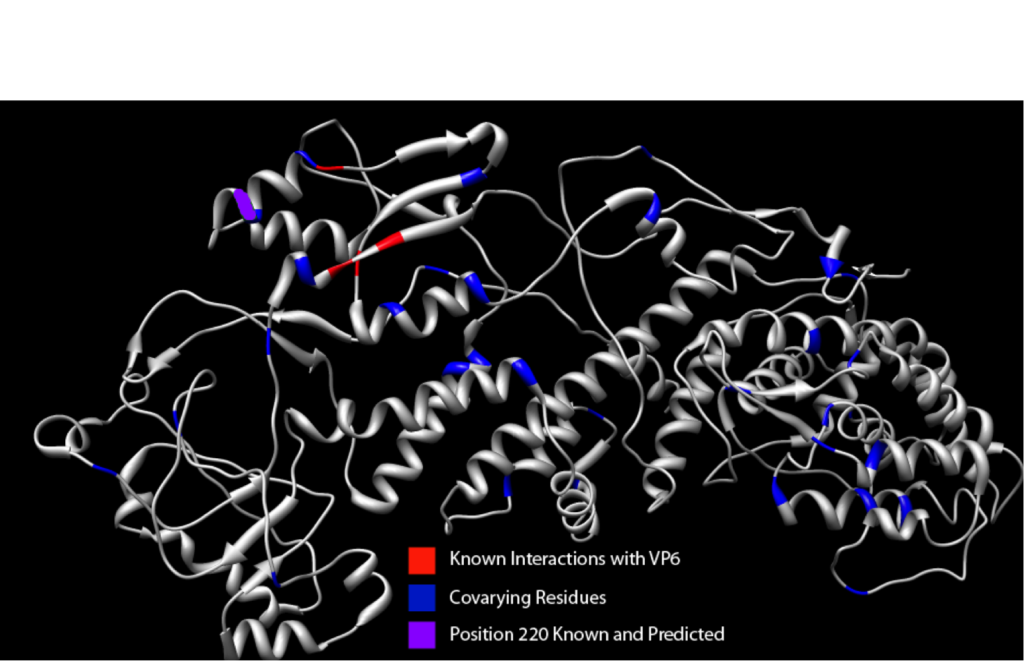
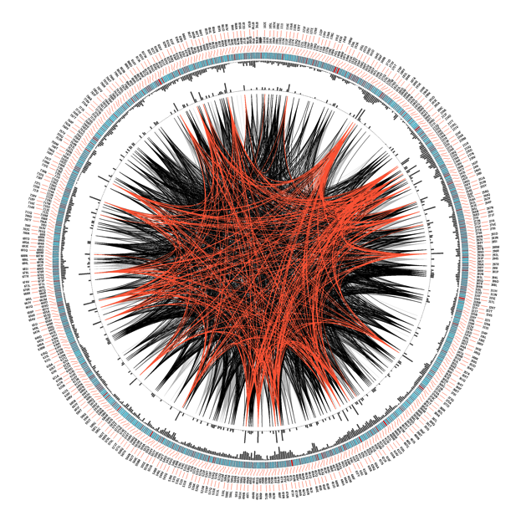
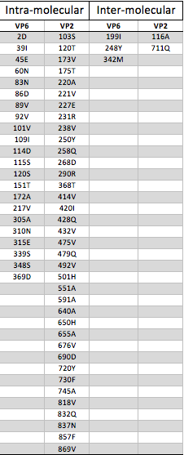
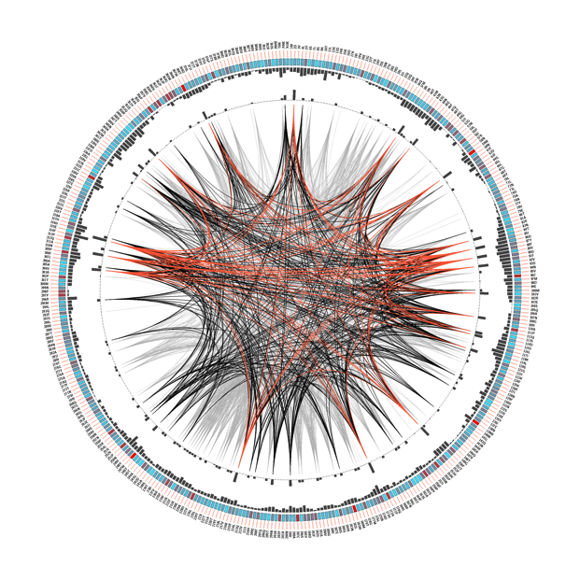


Identification of Rotavirus Protein-Protein Interaction Interfaces By
Using Amino Acid Co-variation Analysis
Travis Thompson¹ and Sarah M. McDonald^{1,2}
¹Virginia Tech Carilion School of Medicine and Research Institute;
²Department of Biomedical Sciences and Pathobiology, Virginia-Maryland Regional College of Veterinary Medicine
Introduction
VP2/VP6 Amino Acid Co-Variation
Structural Analysis of Residues
Rotavirus (RV) is an enteric pathogen that can infect both adults and children, but disease is generally more severe in children.
In addition to infecting humans, RVs are found in nearly every other mammalian and avian species.
The RV virion is a non-enveloped, icosahedral virus with an eleven-segmented double-stranded (ds) RNA genome The 6 structural proteins are VP1, VP2, VP3, VP4, VP6, and VP7. VP6 is the middle of the three protein layers and is the most common antibody target. VP2 is the inner most protein layer and interacts with VP6 and anchors enzymes VP1 and VP3.
One theory for why 'preferred' gene sets are seen among circulating strains is that the genes have functionally co-evolved, where genes are shown to vary together.
Radial Co-variation Diagram
Sequence position and amino acid are listed on the periphery (residue based on bovine RV strain RF as reference). The next layer describes the level of conservation, with red representing highly conserved and blue representing lower conservation. The next 2 layers represent the cumulative MI and proximity MI respectively. In the center of the circle, connections with a MI score greater than 6.5 are shown. The top 5% of co-varying residues are shown in red, the 70-95% are shown in black, and the remaining are shown in gray. A is VP6VP2 concatenation, B VP2, C VP6.
Predicted and Known Interaction Points on the Protein Structure These figures show the respective proteins as isolated from the DLP in Chimera. The locations on the proteins that were predicted by the co-variation analysis are highlighted in blue. The location of known interaction between VP6 and VP2 are highlighted in red. Areas of known VP6-VP6 interaction are highlighted in green. The interaction location that was predicted by the co-variation analysis (VP2 220) is highlighted purple.
A.
A
Typically, a strong correlation between amino acid mutations is interpreted as evidence of functional interactions between proteins that are under substantial selection pressure.
Co-evolution can be supported by correlated amino acid mutation analysis (i.e., amino acid co-variation). Amino acid co-variation has been widely used to infer functional interactions between different sites in a protein.
Research Question: Can co-variation within and between rotavirus proteins predict protein-protein interactions?
Hypothesis: Co-variation within and between VP2 and VP6 will predict known protein-protein interactions.
B.
A
B
VVP6
Methods
C.
Preparing RV VP2 and VP6 amino acid sequence alignments
Nucleotide sequences of 115 RV VP2- and VP6-coding genes were individually downloaded from NCBI GenBank as FASTA files.
Representative gene genotypes were chosen to create a balanced analysis that reflects the known level of RV diversity in nature.
Sequences were organized in a program called Geneious and separated into 3 groups: VP2 sequences, VP6 sequences, and VP6 sequences with VP2 sequences spliced onto the end of the VP6.
Preparing VP2 and VP6 protein structure files
Atomic coordinates of the RV double-layered particle structure were downloaded from the Protein Data Bank (3GZU), from which just the desired protein was isolated. The structure was opened and manipulated using the Chimera software program.
Co-variation analysis using MISTIC
Co-variation analysis was performed using the MISTIC server:
(http://mistic.leloir.org.ar/index.php).
A standard data set included on the MISTIC server was analyzed as the control dataset.
Trimmed multi-sequence alignment NEXUS files were uploaded, and the RF strain of bovine RV was used as the reference.
The prepared PDB files of either VP2 or VP6 were uploaded.
Under the advanced options, sequence clustering was selected, no identity for sequence clustering, low count correction was selected, there we no max fraction of gaps, and a reference sequence was used.
The top 5% of co-varying residues identified by the program were mapped onto the protein structure(s) using the MISTIC interactive network function using the interactive network feature for both the VP6 and VP2 protein.
For the VP6-VP2 co-variation, the locations in the top 5% residues that were not present in the VP6 or VP2 co-variation analysis (individually) were mapped onto the VP6 and VP2 proteins without the previously identified locations.
B.
C.
VP2
Conclusions
The results generated in the study showed a low frequency of identifying the exact location of protein contact.
The areas of known interaction were often flanked by locations identified by this study.
It is possible that the areas of known interaction are so structurally necessary that any change in the amino acids at those locations will prevent the virus from forming and replicating effectively; thus they are highly conserved.
The areas that are near these locations are likely less restricted in amino acid changes but still restricted by other parts of the protein, leading to the co-varying relationship.
This study has provided a rational to hypothesize that co-varying residues in RV proteins may be near sites of direct protein-protein interactions, but they themselves do not comprise direct contact points.
The next steps in the project are to expand the analysis to other RV proteins that are less conserved, to reanalyze using only Wa strains, and to use the RNA instead of protein sequences.
Intra-molecular and Inter-molecular Co-variation (Top 5%) Table
The table shows the sequence location of intra-molecular interactions within VP6 and VP2 in the left 2 columns predicted by the covariation analysis. The right 2 columns show the sequence location of the inter-molecular interactions between VP6 and VP2 that were unique to the concatenated protein and not identified in the intra-molecular analysis. The values used represent the top 5% of the mutual information values for each protein.

